Slide 1

Module 1
Overview of the Data Mining Process
Notes:
Guidelines
Use section headers to chunk content in your presentation.
Use the same style of section header throughout your presentation.
Keep your title to no more than 2 lines.

Slide 2

The Data Mining Process
Notes:
Guidelines
Use a title slide at the beginning of your presentation. There are 9 variations of title slides to choose from.
If you will have a series of slideshows, we recommend using the same style of title slide for each presentation.
Keep your title to no more than 2 lines.
Do not change the font style or font size of the title or subtitle.

Slide 3
Core Ideas in Data Mining
Classification
Prediction (Regression)
Association Rules & Recommenders
Data & Dimension Reduction
Data Exploration
Visualization

Slide 4
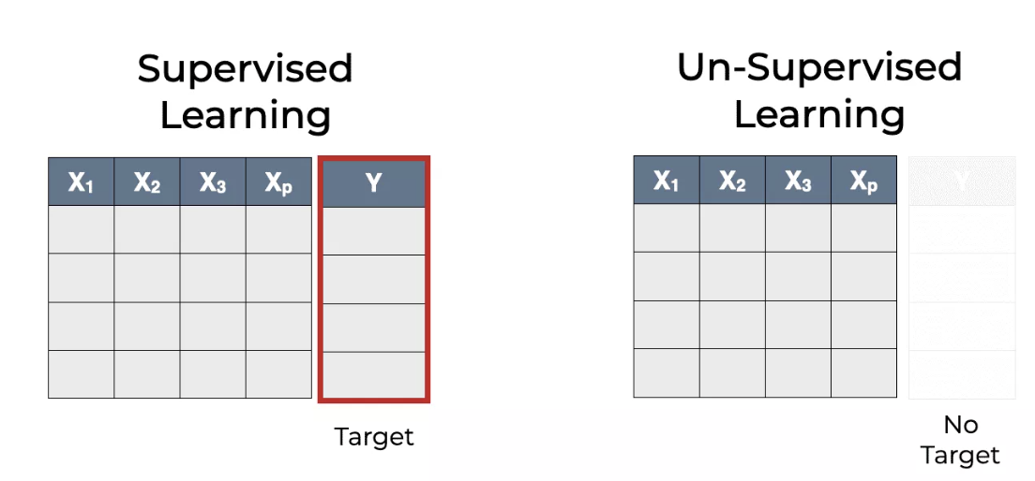
Supervised vs Unsupervised Learning
Supervised: Outcome of interest (response, target) is known
Unsupervised: There is no outcome variable to predict classify

Slide 5
Supervised vs Unsupervised Learning
Notes:
Guidelines
Use a title slide at the beginning of your presentation. There are 9 variations of title slides to choose from.
If you will have a series of slideshows, we recommend using the same style of title slide for each presentation.
Keep your title to no more than 2 lines.
Do not change the font style or font size of the title or subtitle.

Slide 6


Supervised Learning
Goal: Predict “target” or “outcome” variable(s)
Training data, where target value is known
Score to data where value is not known
Methods: Classification and Regression
Score

Slide 7
Supervised Learning
Classification vs Regression
Numeric: Regression or Prediction
Categorical: Classification

Slide 8
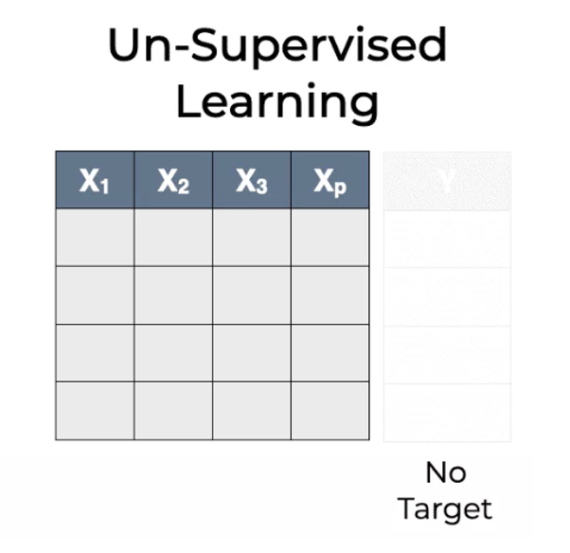
Unsupervised Learning
Goal: Segment data into meaningful segments; detect patterns
There is no target (outcome) variable to predict or classify
Methods: Association rules, collaborative filters, data reduction & exploration, visualization

Slide 9
Supervised Learning
Notes:
Guidelines
Use a title slide at the beginning of your presentation. There are 9 variations of title slides to choose from.
If you will have a series of slideshows, we recommend using the same style of title slide for each presentation.
Keep your title to no more than 2 lines.
Do not change the font style or font size of the title or subtitle.

Slide 10
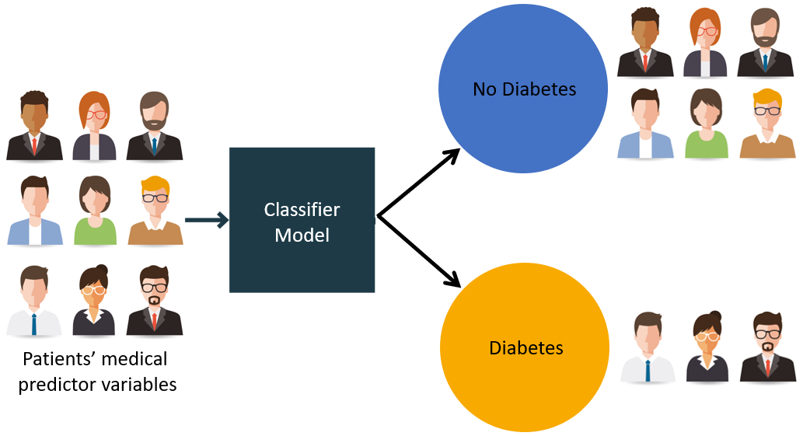
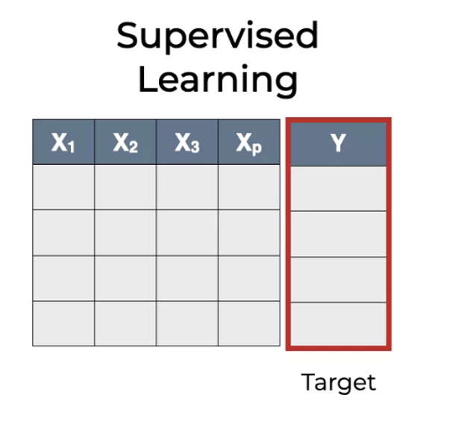
Supervised: Classification
Goal: Predict categorical target (outcome) variable
Examples: Purchase/no purchase, fraud/no fraud, creditworthy/not creditworthy…
Each row is a case (customer, tax return, applicant)
Each column is a variable
Target variable is often binary (yes/no)

Slide 11
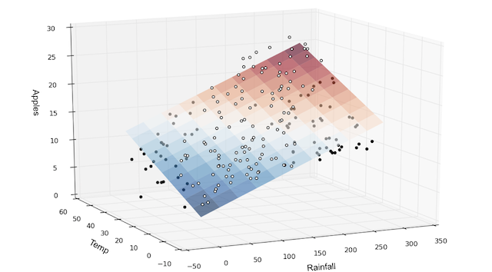
Supervised: Regression
Goal: Predict numerical target (outcome) variable
Examples: sales, revenue, performance
As in classification:
Each row is a case (customer, tax return, applicant)
Each column is a variable
Classification and prediction constitute “predictive analytics”

Slide 12
Unsupervised Learning
Notes:
Guidelines
Use a title slide at the beginning of your presentation. There are 9 variations of title slides to choose from.
If you will have a series of slideshows, we recommend using the same style of title slide for each presentation.
Keep your title to no more than 2 lines.
Do not change the font style or font size of the title or subtitle.

Slide 13
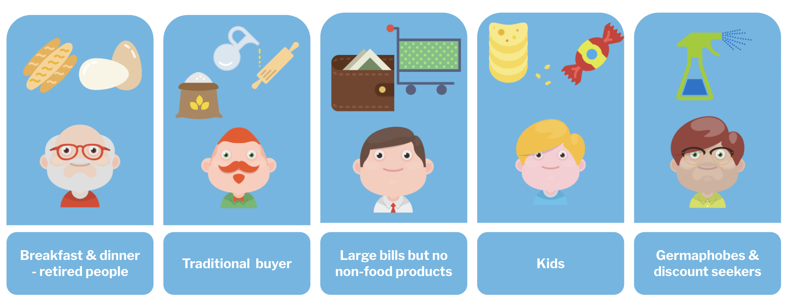
Unsupervised: Association Rules
Goal: Produce rules that define “what goes with what” in transactions
Example: “If X was purchased, Y was also purchased”
Rows are transactions
Used in recommender systems
“Our records show you bought X, you may also like Y”
Also called “affinity analysis”

Slide 14
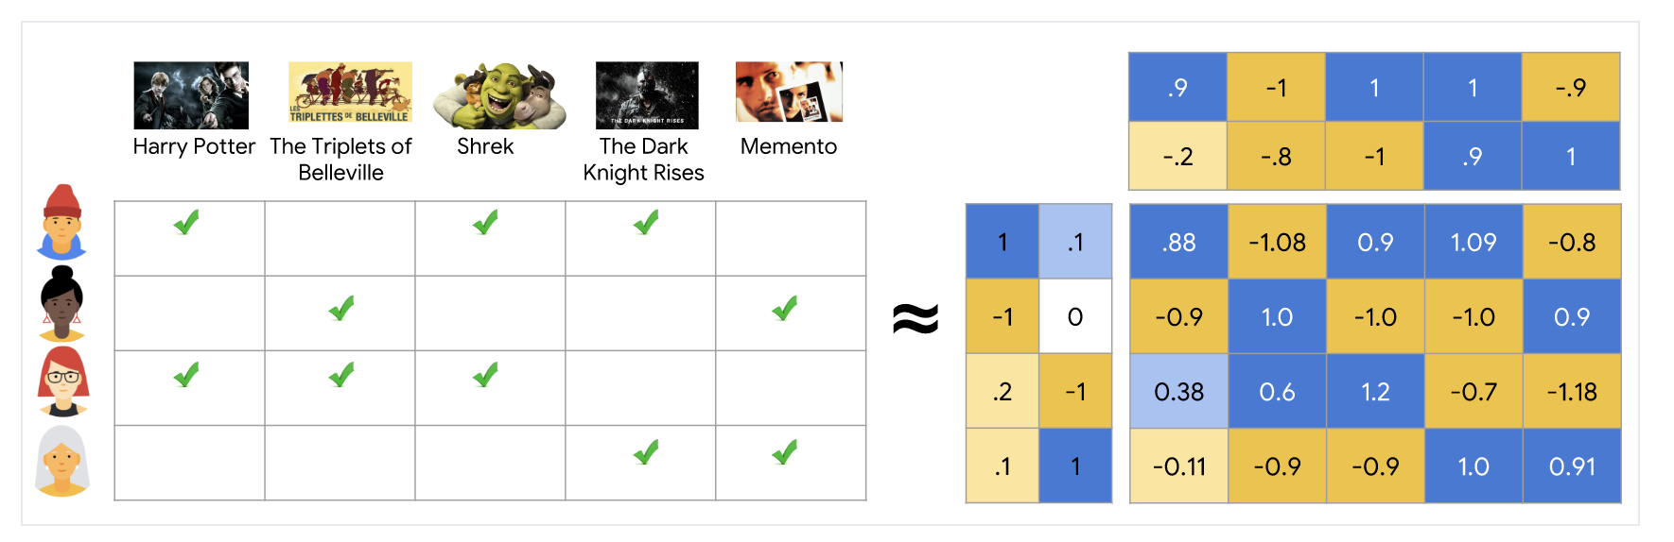
Unsupervised: Collaborative Filtering
Goal: Recommend products to purchase
Based on products that customer rates, selects, views, or purchases
Recommend products that “customers like you” purchase (user-based)
Or, recommend products that share a “product purchaser profile” with your purchases (item-based)

Slide 15
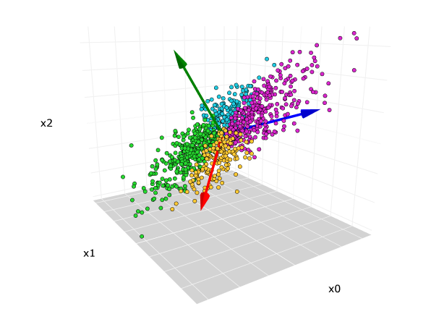
Unsupervised: Data Reduction
Distillation of complex/large data into simpler/smaller data
Reducing the number of variables/columns (e.g., principal components)
Reducing the number of records/rows (e.g., clustering)

Slide 16
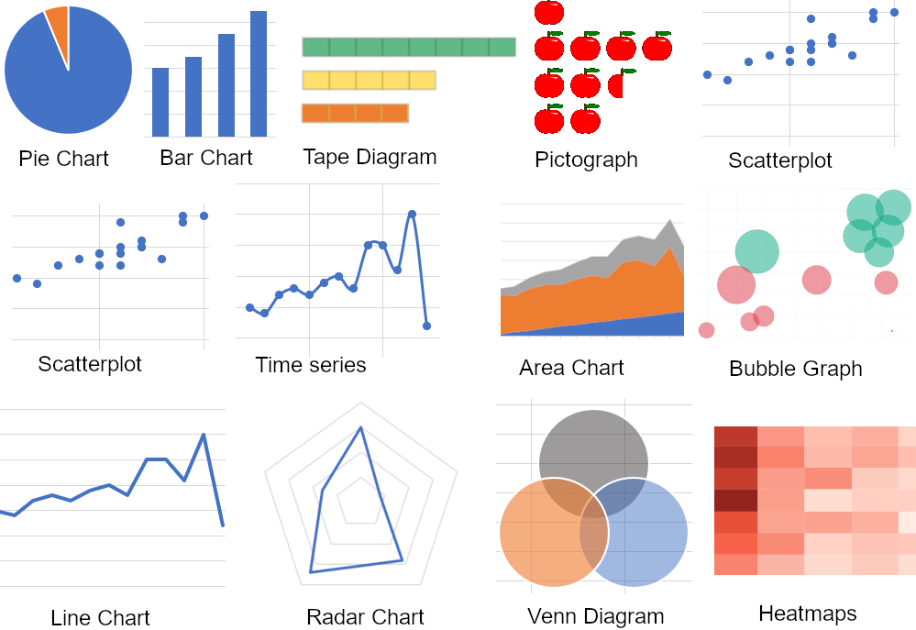
Unsupervised: Visualization
Graphs and plots of data
Histograms, boxplots, bar charts, scatterplots
Especially useful to examine relationships between pairs of variables

Slide 17
Data Exploration (EDA)
Notes:
Guidelines
Use a title slide at the beginning of your presentation. There are 9 variations of title slides to choose from.
If you will have a series of slideshows, we recommend using the same style of title slide for each presentation.
Keep your title to no more than 2 lines.
Do not change the font style or font size of the title or subtitle.

Slide 18
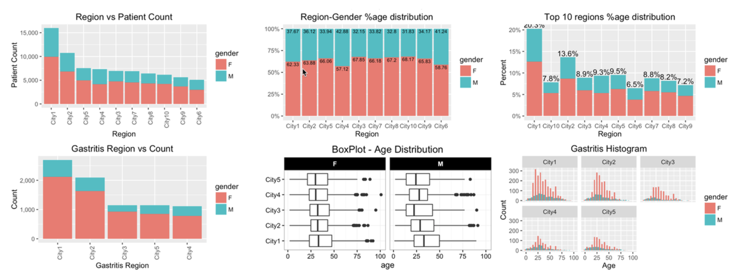
Data Exploration (EDA)
Data sets are typically large, complex & messy
Need to review the data to help refine the task
Use techniques of Reduction and Visualization

Slide 19
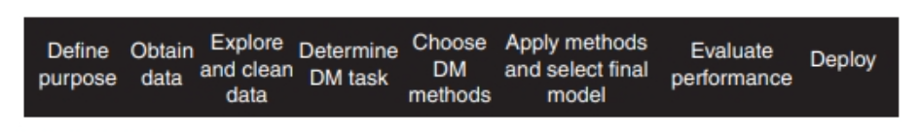
Steps in Data Mining Process
Define Purpose
Obtain Data
Explore & Clean Data
Determine Data Mining Task
Choose Data Mining Methods
Apply Methods and Select Final Model
Evaluate Performance
Deploy

Slide 20

Example: EDA
Notes:
Guidelines
Use a title slide at the beginning of your presentation. There are 9 variations of title slides to choose from.
If you will have a series of slideshows, we recommend using the same style of title slide for each presentation.
Keep your title to no more than 2 lines.
Do not change the font style or font size of the title or subtitle.

Slide 21
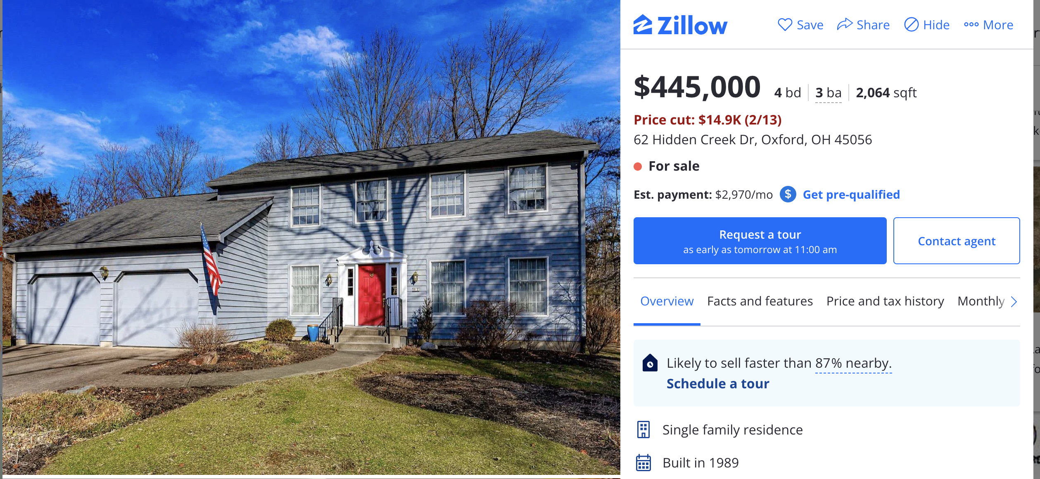
End-to-End DM Project
Zillow is a popular online real estate information website
One of the attractions to Zillow is the “Zestimate”
You are tasked to build a model of housing prices in California

Slide 22
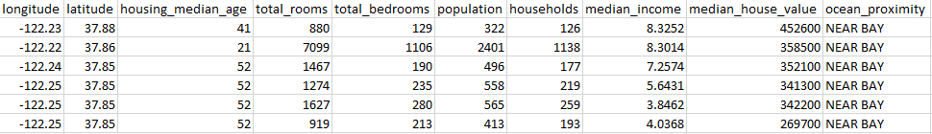
STEP 1: Purpose
Model median home values to predict the median value of homes.
We want to extract information from historical values.

Slide 23
STEP 2: Obtain the data
We already have "labeled" data ready for analysis

Slide 24
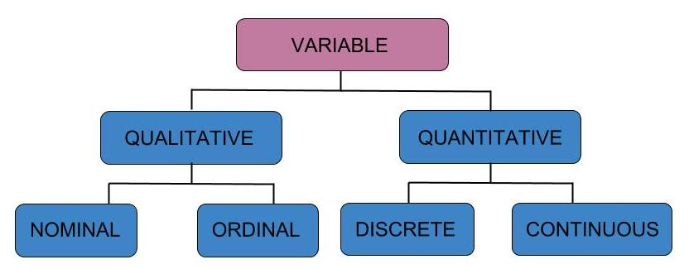
Variable Types
Numeric: float64, int64, int8
Categorical: O, category

Slide 25
Python
Notes:
Guidelines
Use a title slide at the beginning of your presentation. There are 9 variations of title slides to choose from.
If you will have a series of slideshows, we recommend using the same style of title slide for each presentation.
Keep your title to no more than 2 lines.
Do not change the font style or font size of the title or subtitle.

Slide 26
STEP 3: Exploratory Data Analysis
The shape of the data.
Unusual observations.
Missing values.
Highly skewed variables.
Categorical variables with a single value or with too many values.
Low occurrences of levels (categories) of a categorical
Relationships

Slide 27
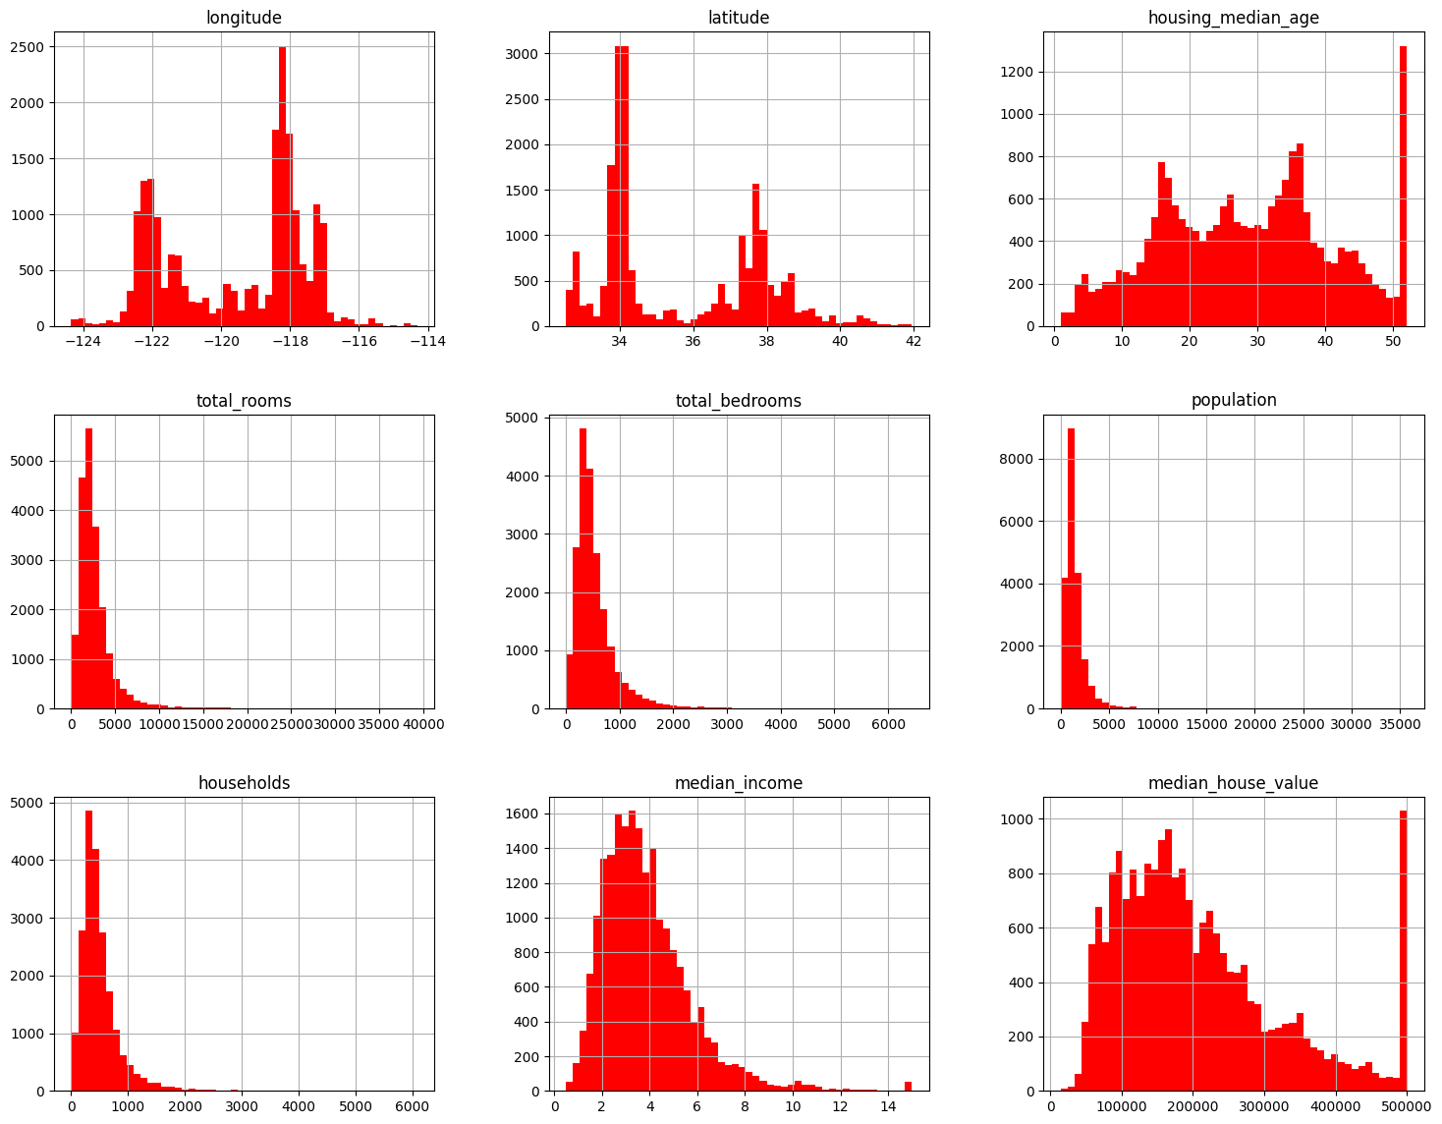
STEP 3: EDA
a) Statistical and Graphical Summaries

Slide 28
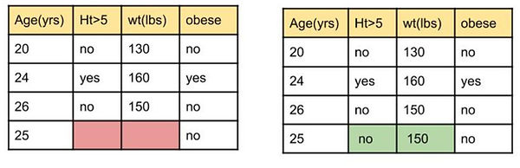
STEP 3: EDA
b) Missing Values and Imputation

Slide 29
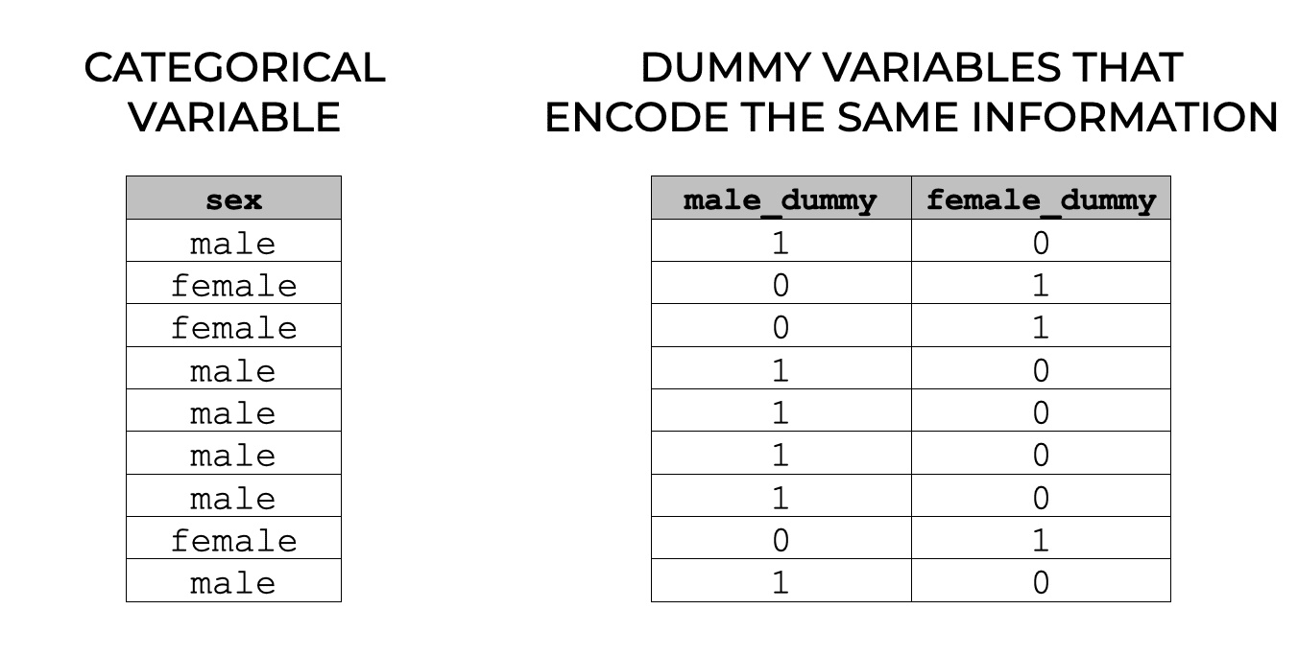
STEP 3: EDA
c) Encoding

